Slide 1



Wavecon Telecom
Insights from Power BI Dashboard
This presentation is part of data analytics internship by code basics and was prepared solely for learning purpose.

Slide 2

About Wavecon Telecom
Wavecon is a premier telecom provider in India, renowned for delivering reliable and cutting-edge services.
In May 2022, Wavecon achieved a significant milestone by introducing its latest 5G services, aiming to offer fast and reliable connectivity to customers. This advancement benefits both individuals and businesses by fostering creativity and innovation. Wavecon operates across 15 major cities in India, maintaining a strong and widespread presence and striving to provide uninterrupted connectivity to its users.
The introduction of 5G services marks a new chapter in Wavecon's history of technological excellence.
This presentation is part of data analytics internship by code basics and was prepared solely for learning purpose. Wavecon Telecom

Slide 3

Agenda
Following the launch of 5G, there has been a noticeable decline in revenue and active users. As a result, they seek insights into the following objectives:
What is the impact of the 5G launch on our revenue?
Which KPI is underperforming after the 5G launch?
After the 5G launch, which plans are performing well in terms of revenue? Which plans are not performing well?
Is there any plan affected largely by the 5G launch? Should we continue or discontinue that plan?
Is there any plan that is discontinued after the 5G launch? What is the reason for it?
This presentation is part of data analytics internship by code basics and was prepared solely for learning purpose. Wavecon Telecom

Slide 4
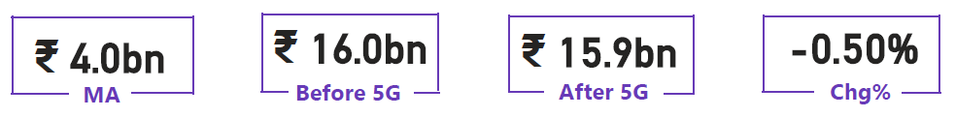
What is the impact of the 5G launch on our revenue?
Revenue
ARPU
TAU
Chg %
KEY HIGHLIGHTS
Mumbai generates the highest revenue while Raipur generates the least.
Revenue dropped by 0.5%
Cities like Mumbai, Bangalore, Pune, Lucknow, Jaipur etc. have shown an increase in revenue.
Monthly Average Revenue = 4Bn
MA – Monthly Average || ARPU – Average Revenue Per Users|| TAU – Total Active Users
This presentation is part of data analytics internship by code basics and was prepared solely for learning purpose. Wavecon Telecom

Slide 5
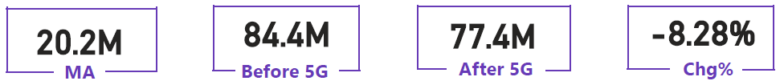
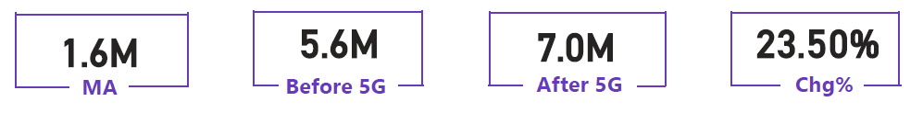
Which KPI is underperforming after the 5G launch?
TAU
TUsU
KEY HIGHLIGHTS
7 million user drop suggests revenue decline.
Pune's 18.06% increase in active users stands out.
Ahmedabad shows the most impact on user base.
Lucknow & Chennai maintain steady active user counts
1.4 million user increase linked to 5G dissatisfaction.
Lucknow sees a 77.91% rise in unsubscribed users.
Mumbai's unsubscribed user rate decreases by 12.63%.
This presentation is part of data analytics internship by code basics and was prepared solely for learning purpose. TAU- Total Active User, TUsU – Total Unsubscribe Users

Slide 6
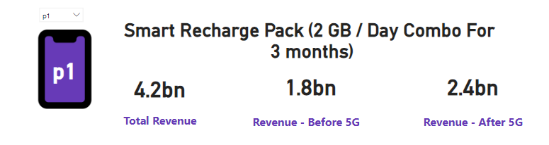
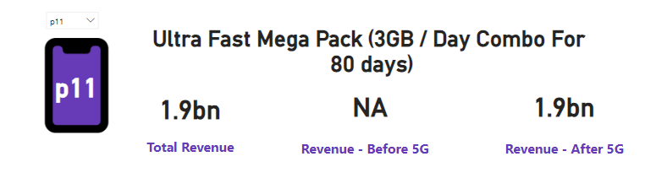
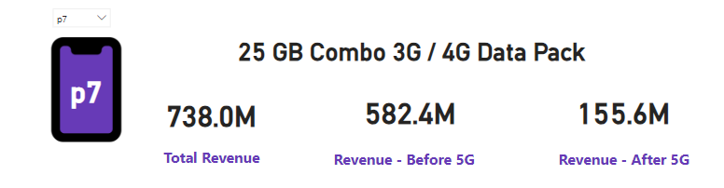
After the 5G launch, Which plans are performing well in terms of revenue? Which plans are not performing well?
KEY HIGHLIGHTS
Plan P1 & P11 show increase in revenue trends.
Among all plans, P11 consistently generates the highest revenue.
Plan P7 show lowest revenue compared to all other plans
This presentation is part of data analytics internship by code basics and was prepared solely for learning purpose. Wavecon Telecom

Slide 7
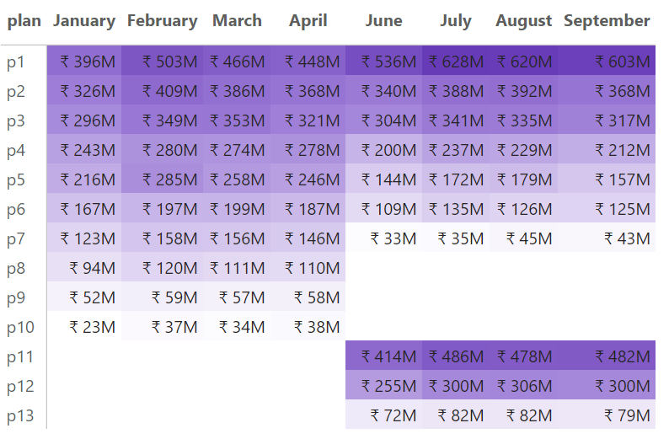
Is there any plan affected largely by the 5G launch? Should we continue or discontinue that plan?
KEY HIGHLIGHTS
Smart Recharge Pack: Revenue increased from ₹1.8B to ₹2.4B, indicating strong performance.
Ultra Fast Mega Pack: New 5G plan, quickly generating ₹1.9B in revenue.
Ultra Duo Data Pack: New 5G plan, achieving ₹1.2B in revenue, showing positive customer response.
25 GB Combo 3G/4G Data Pack (P7) faced a significant revenue drop from ₹582.4 million to ₹155.6 million due to the 5G launch, suggesting it should be discontinued.
This presentation is part of data analytics internship by code basics and was prepared solely for learning purpose. Wavecon Telecom

Slide 8
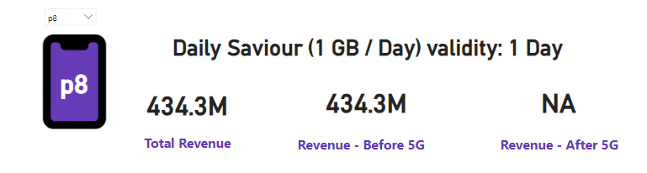
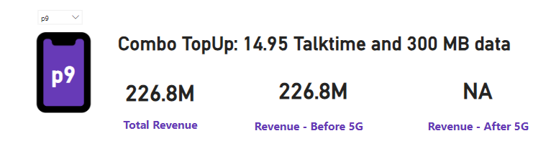
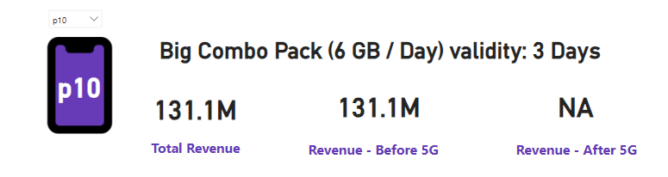
Is there any plan that is discontinued after the 5G launch? What is the reason for it?
KEY HIGHLIGHTS
Plan P8 - Daily Saviour (1 GB/Day): Discontinued due to short validity and inadequate data for 5G demands.
Plan P9 - Combo TopUp (14.95 Talktime and 300 MB Data): Discontinued as consumer preference shifted towards plans with more data and talk time.
Plan P10 - Big Combo Pack (6 GB/Day): Discontinued because of its short 3-day validity not meeting customer expectations for flexibility in data usage.
This presentation is part of data analytics internship by code basics and was prepared solely for learning purpose. Wavecon Telecom

Slide 9
Recommendations:
Network Enhancement: Improve 5G network quality and introduce new compatible devices and services.
Expansion Strategy: Extend 5G coverage and invest in infrastructure to enhance connectivity.
Competitive Pricing: Provide transparent and competitive pricing plans to attract and retain customers.
Customer Focus: Strengthen customer service and support by promptly resolving issues and gathering feedback.
Plan Optimization: Promote high-performing plans and leverage key performance indicators (KPIs) for continuous improvement.
Innovative Offerings: Launch innovative services and features to stand out from competitors.
Digital Transformation: Leverage digital channels for sales, support, and customer engagement to improve accessibility and convenience.
This presentation is part of data analytics internship by code basics and was prepared solely for learning purpose. Wavecon Telecom

